Slide 1
Dominick Aleardi
Software Engineer @ Quicken Loans
F# fanboy
Yes it’s better Dave Bourke, I don’t care about being PC
Contributor to Chessie
Open Source ROP Framework
DominickAleardi@QuickenLoans.com

Slide 2
Railway Oriented Programming
(Monadic Error Handling) To Err is Human; To Forgive Divine
Notes:
The goal of this talk is to have a more deterministic control flow. How do we fail gracefully.

Slide 3
Agenda
Why use ROP
What is ROP
Examples

Slide 4
Why ROP?
More Predictable
More Testable
More Documentable
More Reasonable
Notes:
Hopefully by the end of this you will agree…

Slide 5
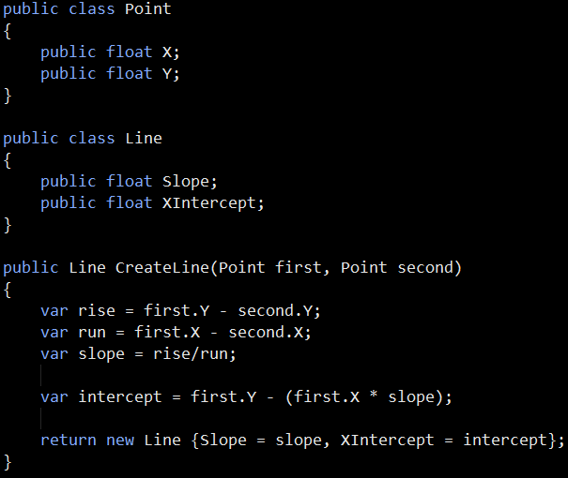
What is wrong here?
Notes:
Divide by zero.

Slide 6
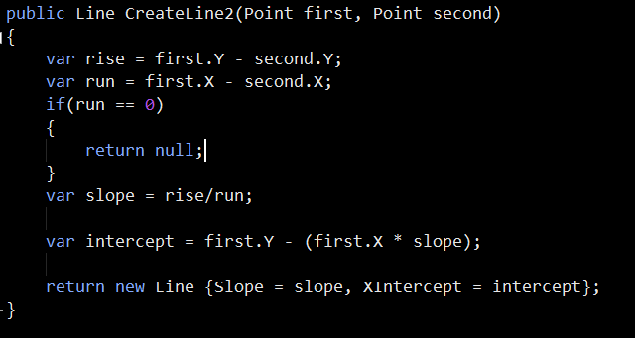
What can we do?
Return Null?

Slide 7
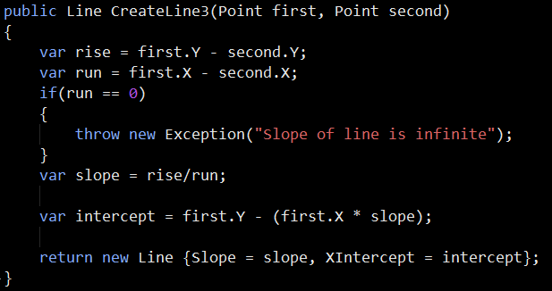
What can we do?
Throw Exception?

Slide 8
Why is this bad?
To know these are possible you must look at documentation or more likely get an unhandled run time exception.
Checking for them is not enforced by the compiler.
Makes it harder to reason about code. Null and exceptions are not the return type of Line. It negates the purpose of static types!
Exceptions make it harder to multi-thread code.

Slide 9
What is ROP?
Programming style to handle errors in a type safe way.
All of this stolen from Scott W.
He has 2 videos and several blog posts
http://fsharpforfunandprofit.com/
Notes:
The goal of this presentation is to get you to go to his blog!

Slide 10
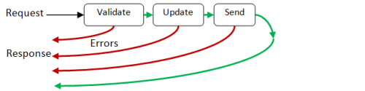
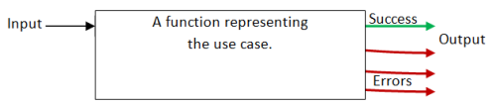
What is ROP?
Non Functional:
Returns early through nulls or exceptions
Functional:
Build a function that returns strongly typed response of either a success or error.
Notes:
Non Funtional: bad because the compiler does not force you to handle it.

Slide 11

Try Not!
Do or Do Not.
There is no
Try{}
Catch{}
Notes:
Golden Rule

Slide 12
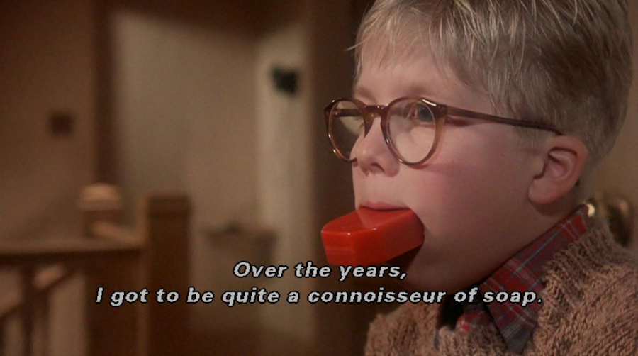
Watch Your language
Notes:
Dirty Words:
Monoid
Monad
I have another version of this talk that goes over the theory. Ask me afterward if you want to know more.

Slide 13


Two Track Result
Switch Function
Notes:
This is why the term Railway Oriented Programming.

Slide 14
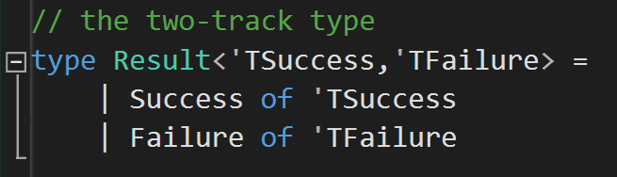
Two Track Result

Slide 15
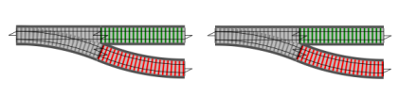

Bind: building the Railroad

Slide 16
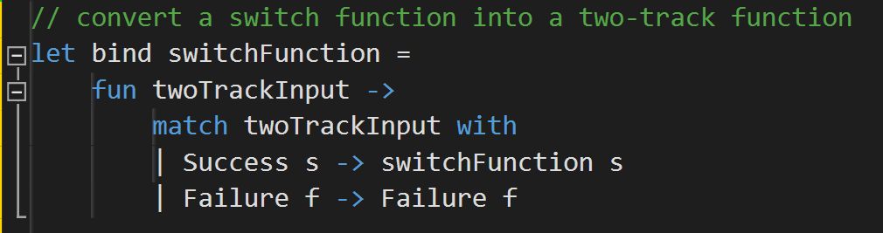

Bind: building the Railroad

Slide 17

Bind: building the Railroad
Notes:
We can see our Railroad begin to work

Slide 18
Lets play around
First Code sample

Slide 19
You now know 80% of ROP and 2% of Monads Lets make this more Robust
Congratulations!!!

Slide 20
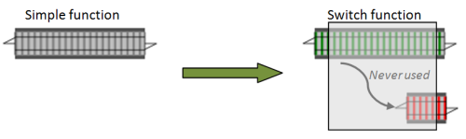
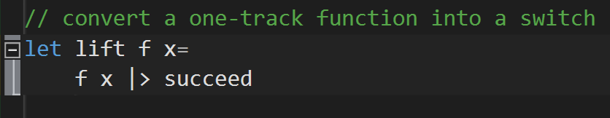
Lift: Handling One Track Functions
Notes:
What do we do for functions that don’t throw errors?

Slide 21
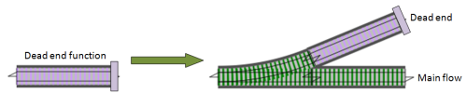
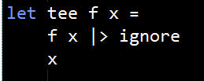
Tee: Handling Dead End Functions

Slide 22
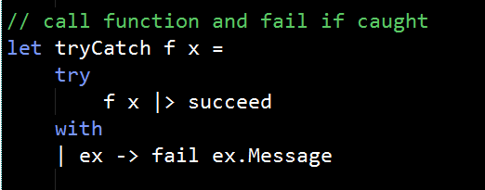
tryCatch: Handling exceptions

Slide 23
Lets play around
second Code sample

Slide 24
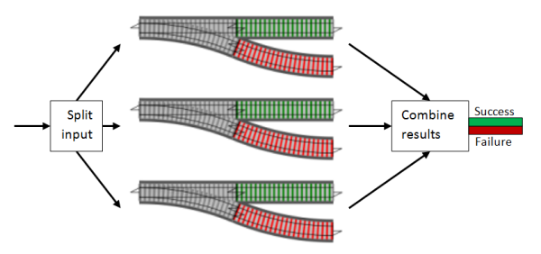
What if I want to do these in parallel?
Notes:
Works great if your

Slide 25
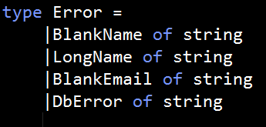
Strong Error Types
You want to use DUs instead of strings for your error messages

Slide 26
Lets play around
Third Code sample

Slide 27
Chessie
Tale of 3 Night Clubs
F#
C#

Slide 28
Thank You
Dominick Aleardi
Software Engineer @ Quicken Loans
Daleardi@Gmail.com

Slide 29
Other Topics
Injecting functions into flow based on application inputs/configuration
Adding Warning Messages to your success type
Adding Warning Type: Three track model
Doing this asynchronously
Creating Computation Expression to do this
Read Scott W.’s blog!

